Slide 1
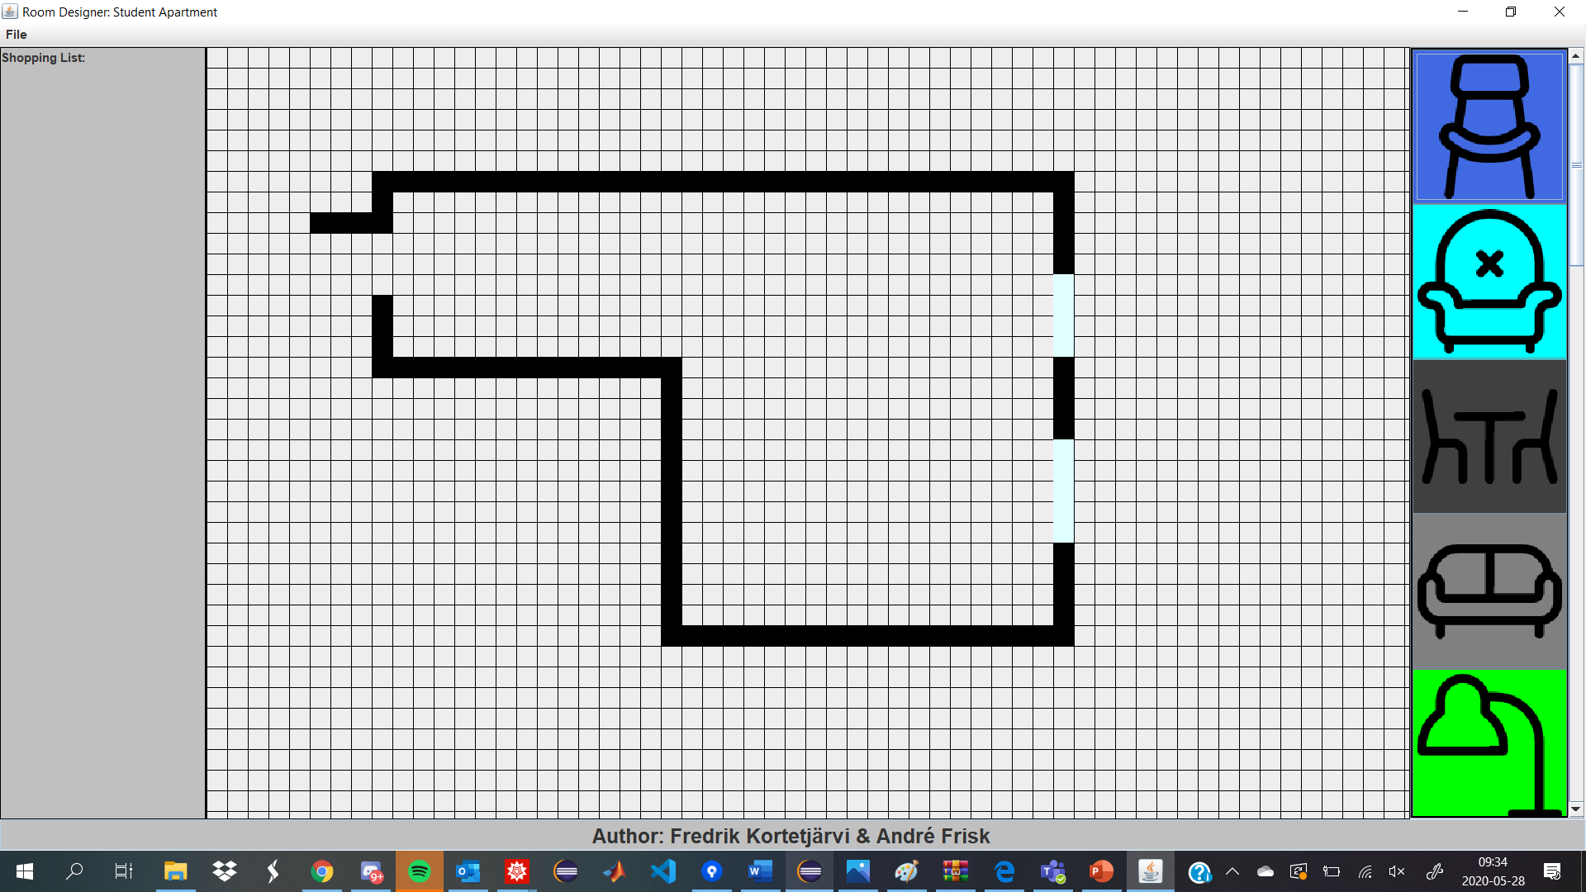
Room Designer

Slide 2
Why did we choose Room Designer?
Electronics and components are not our area of expertise
Requirements:
- GUI - Updated ShoppingList - A variety of furnitures - Save and Load functions - A security function for doors/windows

Slide 3
Design of the program
Layout
Organized
Divided

Slide 4
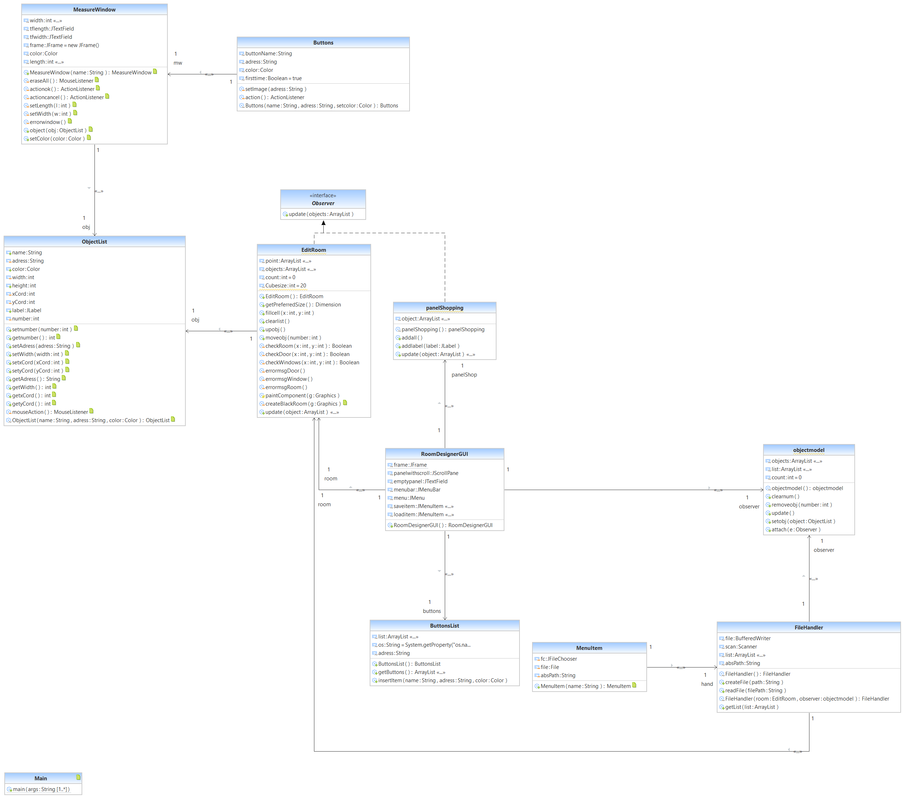
Structure
Frame
Observer

Slide 5
What could we do better?
Non-stackable furnitures
Paint out your own room of choice
A real life printable shopping list

